Slide 1





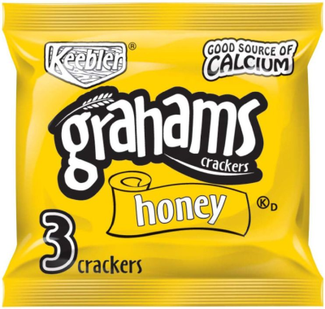
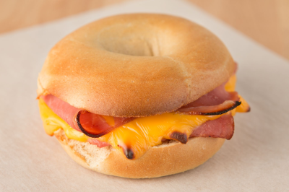
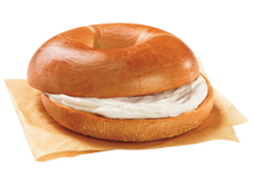
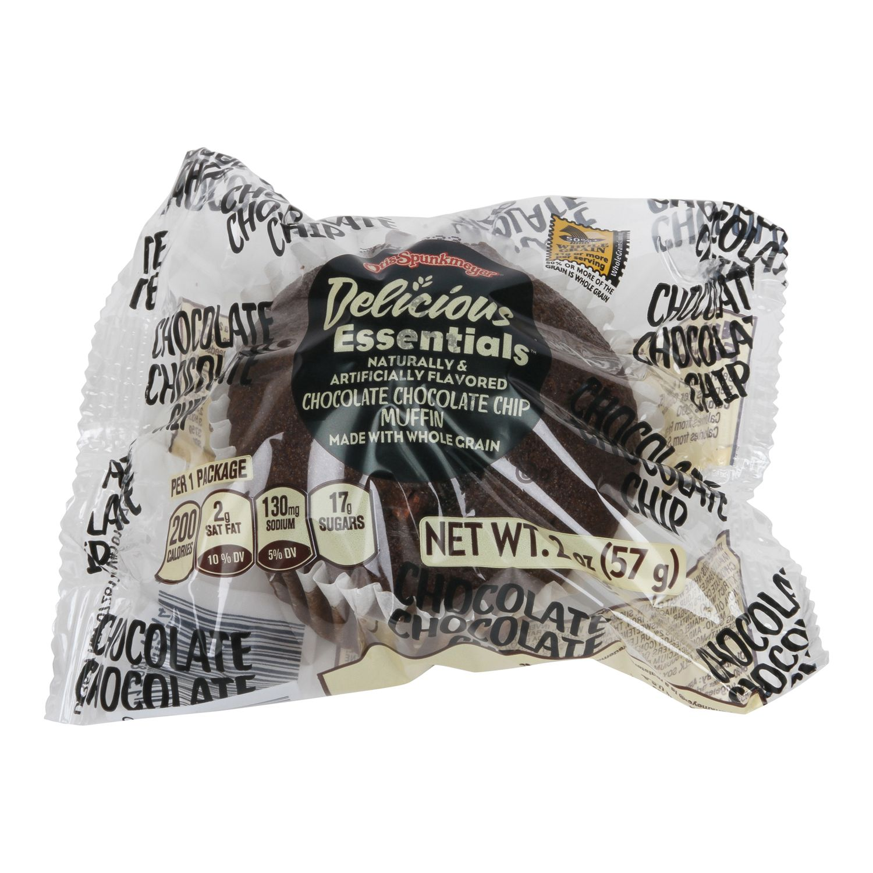

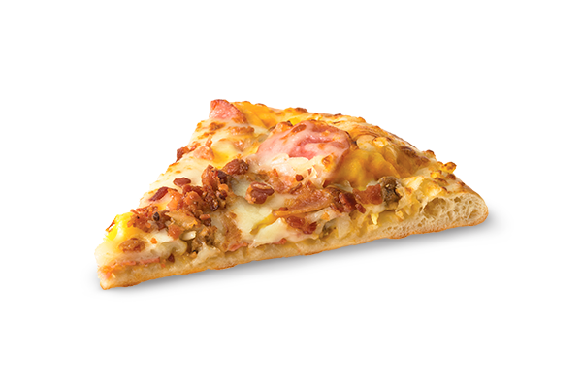

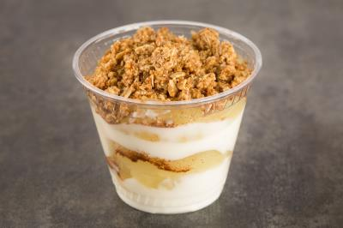

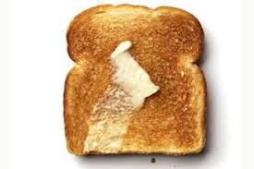
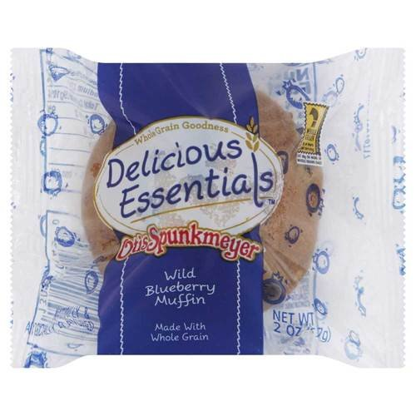




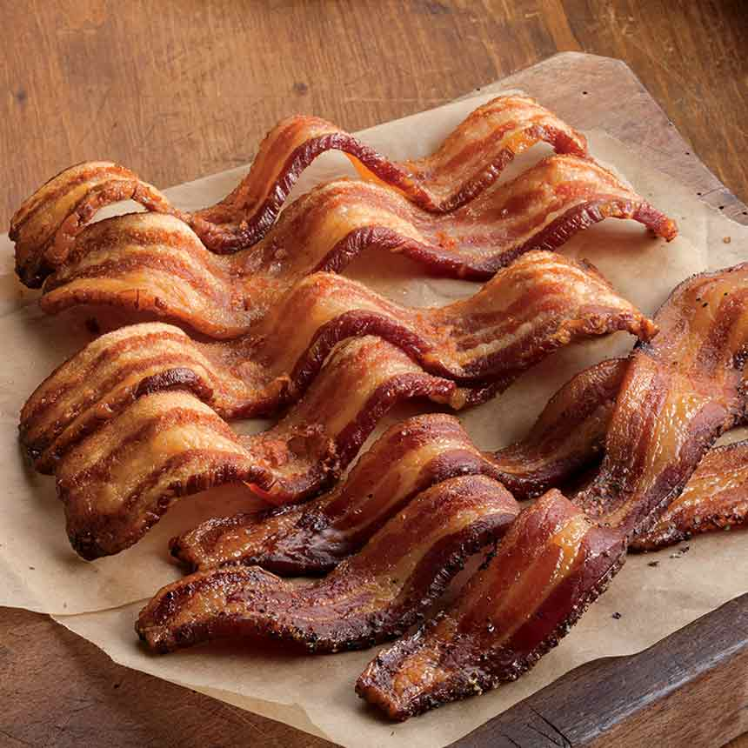


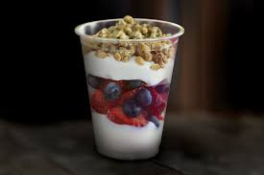


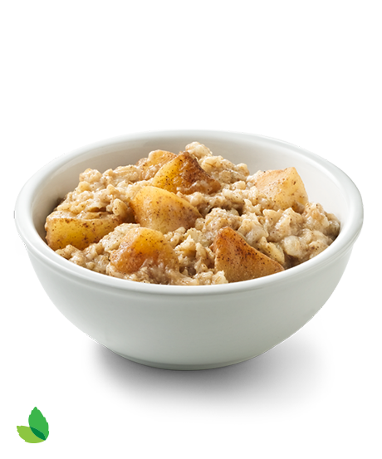
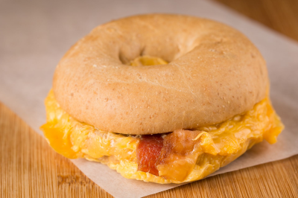


Mill October Breakfast Menu
Staff Price $4.35
Monday | Tuesday | Wednesday | Thursday | Friday
3 Pineapple Orange Smoothie Honey Graham Crackers Assorted Fruit Juice Assorted Chilled Fruit Assorted Fresh Local Seasonal Fruit | 4 Ham, Egg, and Cheese Bagel Sandwich Assorted Fruit Juice Assorted Chilled Fruit Assorted Fresh Local Seasonal Fruit | 5 | 6 Bagel with Cream Cheese, Sunbutter or Grape Jelly Assorted Fruit Juice Assorted Chilled Fruit Assorted Fresh Local Seasonal Fruit | 7 Whole grain Double Chocolate Chip Muffin Assorted Fruit Juice Assorted Chilled Fruit Assorted Fresh Local Seasonal Fruit
10 | 11 Scrambled Egg Pizza Assorted Fruit Juice Assorted Chilled Fruit Assorted Fresh Local Seasonal Fruit | 12 Strawberry Banana Smoothie Honey Graham Crackers Assorted Fruit Juice Assorted Chilled Fruit Assorted Fresh Local Seasonal Fruit | 13 Apple Cinnamon Yogurt Parfait With Homemade Granola Assorted Fruit Juice Assorted Chilled Fruit Assorted Fresh Local Seasonal Fruit | 14 Scrambled Eggs with Cheese Whole Wheat Toast Assorted Fruit Juice Assorted Chilled Fruit Assorted Fresh Local Seasonal Fruit
17 Two Whole Grain Waffles Two Pork Sausage Links Assorted Fruit Juice Assorted Chilled Fruit Assorted Fresh Local Seasonal Fruit | 18 Whole Grain Blueberry Muffin Assorted Fruit Juice Assorted Chilled Fruit Assorted Fresh Local Seasonal Fruit | 19 Pink Lemonade Smoothie Honey Graham Crackers Assorted Fruit Juice Assorted Chilled Fruit Assorted Fresh Local Seasonal Fruit | 20 Two Warm Pancakes With Crispy Bacon Assorted Fruit Juice Assorted Chilled Fruit Assorted Fresh Local Seasonal Fruit | 21 Sausage, Egg, and Cheese Biscuit Sandwich Assorted Fruit Juice Assorted Chilled Fruit Assorted Fresh Local Seasonal Fruit
24 Colby Jack Cheese Omelet Whole Wheat Toast Assorted Fruit Juice Assorted Chilled Fruit Assorted Fresh Local Seasonal Fruit | 25 Blueberry/Strawberry French Toast Parfait Assorted Fruit Juice Assorted Chilled Fruit Assorted Fresh Local Seasonal Fruit | 26 Three French Toast Sticks 2 Slices Crispy Bacon Assorted Fruit Juice Assorted Chilled Fruit Assorted Fresh Local Seasonal Fruit | 27 Banana Split Smoothie Honey Graham Crackers Assorted Fruit Juice Assorted Chilled Fruit Assorted Fresh Local Seasonal Fruit | 28 Apple Cinnamon Oatmeal Assorted Fruit Juice Assorted Chilled Fruit Assorted Fresh Local Seasonal Fruit
31 Bacon, Egg, and Cheese Bagel Sandwich Assorted Fruit Juice Assorted Chilled Fruit Assorted Fresh Local Seasonal Fruit
Assorted Low Sugar Cereal w/ String Cheese or Yogurt | Assorted Low Sugar Cereal w/ String Cheese or Yogurt | Assorted Low Sugar Cereal w/ String Cheese or Yogurt | Assorted Low Sugar Cereal w/ String Cheese or Yogurt | Assorted Low Sugar Cereal w/ String Cheese or Yogurt
.
BREAKFAST: A full student breakfast includes a choice of entree supplying grain and/or protein, two (2) fruit side dishes and choice of milk. Milk choices include 1% white, skim strawberry and skim chocolate.
Visit:
Visit aces.nutrislice.com to see your menu!
Locally Grown
Vegetarian
USDA is an equal opportunity employer and provider

