Slide 1
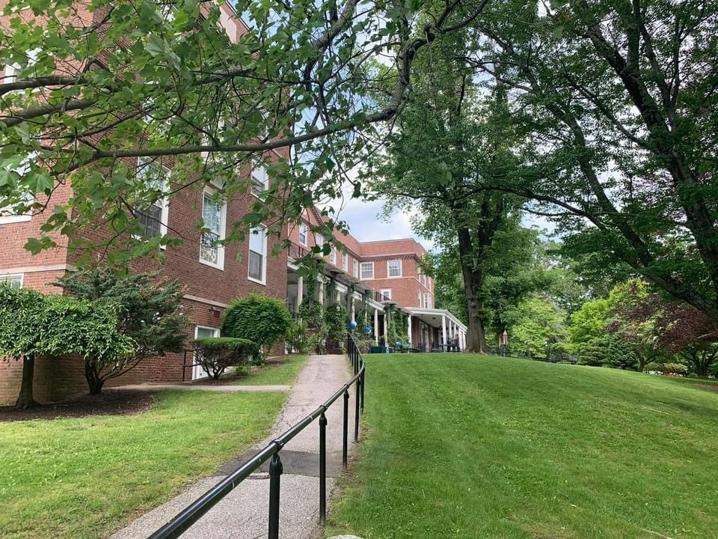
ACES at Chase
Orientation

Slide 2
Welcome to ACES at Chase a STEAM Magnet School!
Magnet schools are diverse! That is ONE of their awesome characteristics and we value diversity! Students enter magnet schools from different
Schools
Towns
Ethnicities
Religions
Cultures
Socio-economic backgrounds
Our Magnet is STEAM: Science, Technology, Engineering, Arts, and Mathematics
Students are attending ACES at Chase from 26 towns!

Slide 3
After School and Before School Programs
After School Programming
Sports will start right away
All other programs will begin in October
We have many clubs and activities for all student interests.
Before School Program
We just received federal funding to help decrease learning loss through ESSeR funds.
Before School Extra Help will begin in October at the earliest.

Slide 4
Bus Information
First Student buses are transporting all ACES at Chase students.
Bus stops are determined by the bus company to accommodate students from the entire region.
CALL ACES Parent Choice with any busing concerns
Students:
Wear masks at all times on the bus
Fill seats from the back to the front and sit in the SAME seats on the way home so you don’t have to walk by people when you enter OR exit the bus. (COVID Protocol)
Bus Expectations
Use your quiet voice
Stay in your seat
Keep hands, feet, and objects to yourself
Walk to the bus using the sidewalk wherever you are entering or exiting

Slide 5
COVID Protocols and Requirements
All ACES at Chase staff must be immunized or will undergo weekly COVID testing (state and district requirement)
We recommend students 12 and over are immunized, but that is a family decision and NOT a requirement for students.
Any individual who is fully vaccinated does not need to quarantine if exposed to COVID-19, unless they are symptomatic.
ALL students and staff will wear masks daily - during school hours and on the buses at all times - until further notice.
Each classroom, office, and large group area have Hepa Filters, hand sanitizer, and sanitizing wipes to help keep our students and staff safe and our working areas sanitized to the best of our ability.

Slide 6
Breakfast (Free)
When? 7:45 - 8:10 AM
Where?
Camp Hall (grade 6) in the main entrance of the building
Upper School (grade 7 and 8) in the lobby/ classrooms.
How?
Students will pick up their breakfast and be directed to either a team classroom, or another space in the building to eat.
Your first class starts at 8:15 AM, so you must be in your first class on time. Plan accordingly, students!

Slide 7
Lunch and Dining Hall Procedures
Lunch (Free) is served in the Dining Hall in the Main Building.
Students will walk to one of the two Dining Halls and be seated.
Students will be called up to get food.
Dining Hall Expectations:
Stay healthy by eating lunch every day.
Clear your table and your space for the next person.
Stay seated.
Push in your chair when you leave.

Slide 8
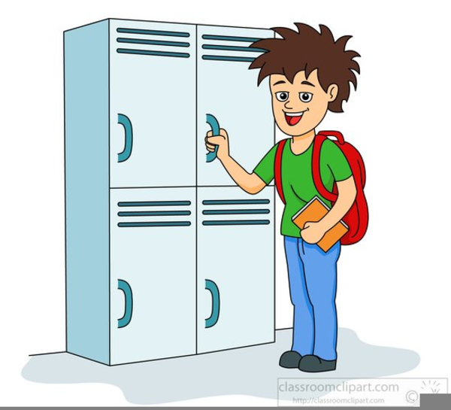
Lockers and Backpacks
Backpacks:
Backpacks may be worn to Creative Arts classes and to and from school.
Otherwise they belong in lockers.
Lockers
ACES at Chase lockers are very large
Two students will share one locker space.
Lockers will not be locked
Heavy outerwear, backpacks, and gym clothing will be stored in lockers

Slide 9
Dress Guidelines
Please check our Dress Code Guidelines on our webpage!
www.aces.org/chase

Slide 10
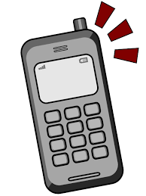
Cell Phones and Usage at School
Many students have cell phones and need them when away from home and traveling on the bus, etc.
During school hours, cell phones need to be off and away so they are not disruptive or used inappropriately. This rule will be strictly enforced.
Students may keep their phones with them because lockers are not lockable.

Slide 11
Medical Information Requirements
All new students need a physical on file at ACES at Chase. We need to have medical information on all students in case there is an emergency and a nurse needs to refer to your child’s medical history.
ALL 7th graders must have an up-to-date physical and immunization record on file at school or they cannot attend school (as per state law).
Any medications taken at school need a medical authorization form signed.
If your child has an allergy, a form and an emergency allergy treatment form must be completed and signed.
If your child has asthma, an Asthma Action Plan must be on file at school with details for treatment.
FORMS DUE BY SEPT. 3RD - no later! (Or proof of a doctor’s appt.)
****See the school nurses today with any questions or if you need to drop off a form or medications. ****

Slide 12
One To One Laptop Programming
ACES at Chase is a 121 Laptop Community! All students and staff members have laptops.
EVERYONE must sign the ACES Responsible Use Code of Conduct. (The form was send home through ParentSquare.) No student will receive a laptop unless this form is signed. If you need help - please ask today!
Student Chromebooks will be rolled out early in September:
September 7th - All Laptops Rolled Out to as many grade levels as possible.
September 8th - Completion of Rollout

Slide 13
Tardy to School?? Or Early Dismissal?
Parent/Guardian
Park in the main parking lot
Walk to the Main Building
Contact the school, DO NOT text your child! Phones need to be off and away.
Speak to the secretary to either get a tardy pass for the student or have the student called to the Main Building for dismissal.
IF YOU KNOW IN ADVANCE OF THE NEED FOR EARLY DISMISSAL, please call the main office and/or send a note with your child.
No Early Dismissals past 2:40 PM.

Slide 14
Parent/Guardian Drop-off and Pick-up Location
If students are being driven to and from school there is ONE location - GOSS FIELD HOUSE for students to be dropped off in the morning, and picked up at dismissal time in the afternoon.
Stay in line - DO Not jump the line or drive around another vehicle.
Drive to the patio area in front of the Field House entrance.
Student will get in/out of the car.
Follow the arrows on the lot driveway.
Watch for students at all times.
Drop-off time: 7:45 AM to 8:00 AM
Pick-up time: 2:50 PM - 3:00 PM

Slide 15
Schedules, Teams, Passing Times, Oh My!
Student Schedules will be handed out on the first day of school.
Team Assignments have been shared through ParentSquare. If you don’t know your team, please see an administrator or staff member today!
Passing Times and Finding Your Way Around Campus:
Teachers will escort students the first few days everywhere they go so all will become familiar with the school.
Then students will be responsible to walk to the buildings where their classes are located.
Teachers will be on duty during passing time on all walkways to supervise.
Passing time is 5 minutes. All students are expected to go directly to class and be on time.

Slide 16
Team Assignments - more details
Grade 6: Three Teams of about 90 students and 4 teachers
Grade 7 and 8: Two Teams of about 135 students and 5 teachers
We DO NOT place students on teams because their friends on on that team!
A magnet school is a place to meet new people and make new friends!
All Teams are designed to be the same cross-sectionally - same number of students from each town, same number of boys/girls, same ethnicity breakdown on each team, all academic abilities on each team, etc. We do reserve the right to adjust teams once our enrollment steadies. We expect some attrition and have to make sure we balance teams as students come and go the first month.

Slide 17
What Does a Typical Day Look Like for Students?
Academics
Each student will have 4 academic classes in grade 6 and 5 academic classes in grade 7 and 8, each day Math, Social Studies, Science, and Language Arts and Spanish (gr. 7 & 8).
W.I.N. (What I Need)
L.E.A.P. (Learn, Explore, Achieve, Prepare)
Creative Arts
Physical Education
Music
Art
Health
Project Adventure
Project Lead the Way

Slide 18
Advisory Group on Monday Mornings
Every student and staff member will be involved in an ADVISORY GROUP this year at ACES at Chase.
You will:
Be in small groups
Get to know one another
Play games
Talk about silly and serious stuff
Check your grades
Set goals for yourself
Advisory is a great place to become connected to a staff member and meet new friends.

Slide 19
Power School and ParentSquare
ParentSquare - Download the APP today!
Our communication tool
Teachers, teams and activity groups will create distribution lists
You will be able to message and respond to posts.
ParentSquare syncs with Power School. Make sure your Power School contact information is accurate by completing the student registration form!
Power School:
Our grading program
Our student database
Parents/guardians will have access to Power School.
Logins and Passwords will be sent home ASAP in hard copy.

Slide 20
Parents and Teachers As Partners (PTAP)
Monthly meetings:
1st Tuesday of the month
6-7 PM
Membership is $5 per family.
All money earned through dues and fundraisers goes toward helping provide ALL students with access to field studies, enrichment opportunities, teacher appreciation days, and supplies that are needed for various student groups at ACES at Chase.

Slide 21
Forms to complete on ParentSquare
Responsible Use Code of Conduct Form by Sept. 6th!
Student Registration Form
Student Media Release

Slide 22
Campus Tours and Questions
If you wish to tour the campus, please line up by the big tree directly across from me???
Groups of 10-15 will be assigned to a staff member. Ask questions!

